Slide 1
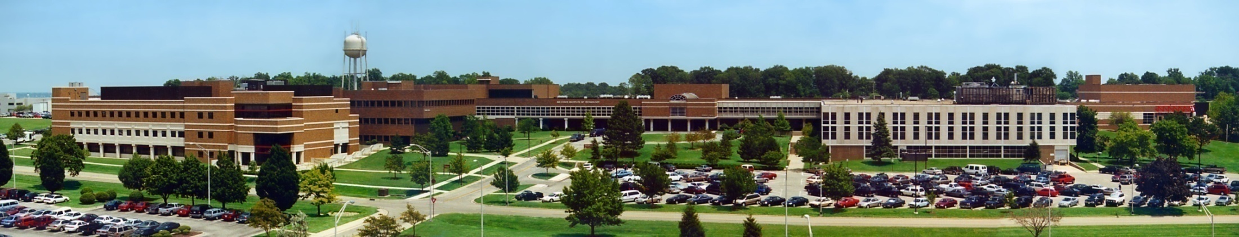
CSCE 693 – Software Evolution Game Engine Design: Fixed Frame Rate
Air Force Institute of Technology
Douglas D. Hodson, PhD
Bldg 640, Room 311C
255-3636 x4719

Slide 2

Existing Game Loop Code Needs Improvement

Slide 3
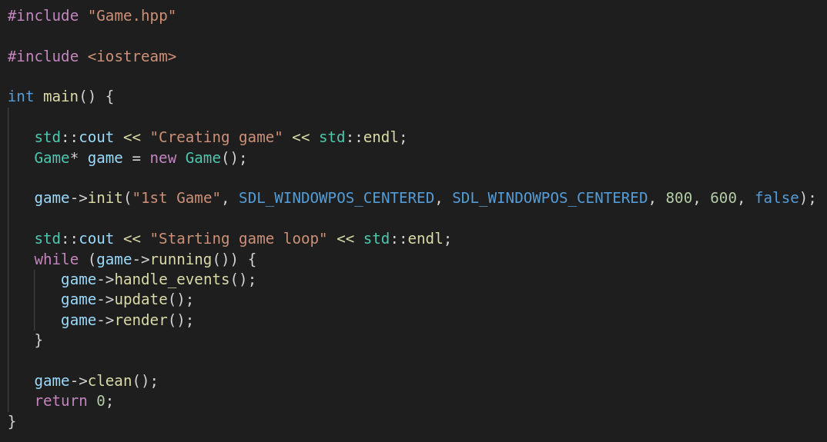
main.cpp
Creates resources (an SDL2 window and renderer)
Issues
Using new
Missing delete
Deletes resources (SDL2 window and renderer), but NOT the object itself!

Slide 4
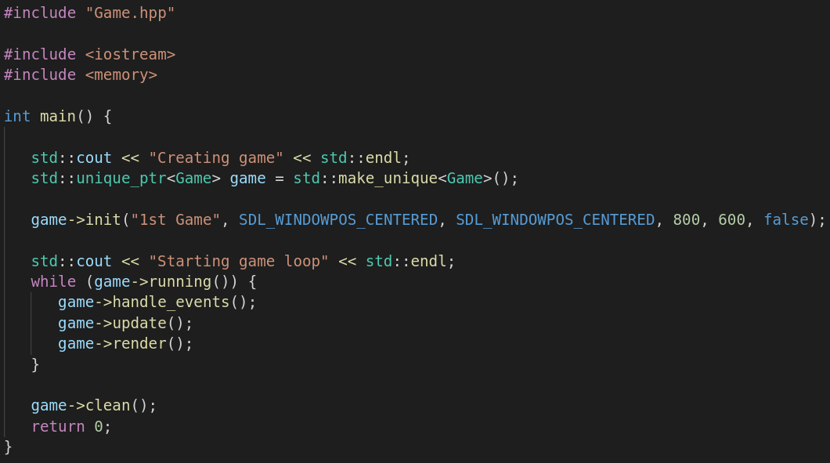
main.cpp
Improved
Using unique_ptr
Automatically deletes when object falls out of scope (heap memory is freed)
Much better, but init() and clean() are yuk

Slide 5
main.cpp
Highlighted code looks like things to be done during construction and destruction
I’m thinking this is a perfect application of RAII !

Slide 6
RAII (Resource Acquisition Is Initialization)

Slide 7
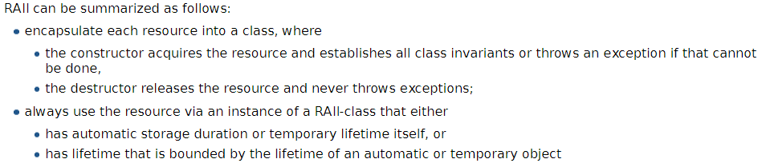
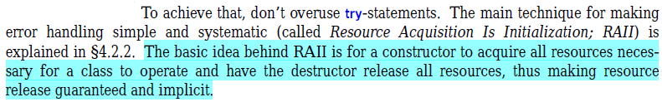

RAII in Review
About binding the life cycle of a resource that must be acquired before use to the lifetime of an object
Examples: allocated heap memory, thread of execution, open socket, open file, locked mutex, disk space, database connection – anything that exists in limited supply

Slide 8
Applying RAII to Game Class
Resources
Initializing SDL2 ?
SDL_Init() should be paired with SDL_Quit()
SDL2 window
SDL2 renderer
Initializing SDL2, creating a window and creating a renderer looks like things to be “acquired”
init() functionality -> constructor
Releasing them appears to be things that should be done the destructor
clean() functionality -> destructor

Slide 9
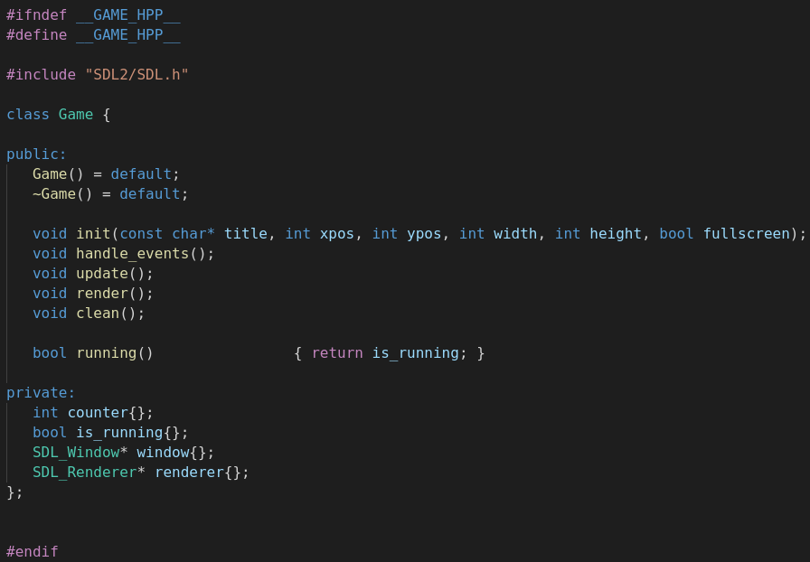
Game.hpp

Slide 10
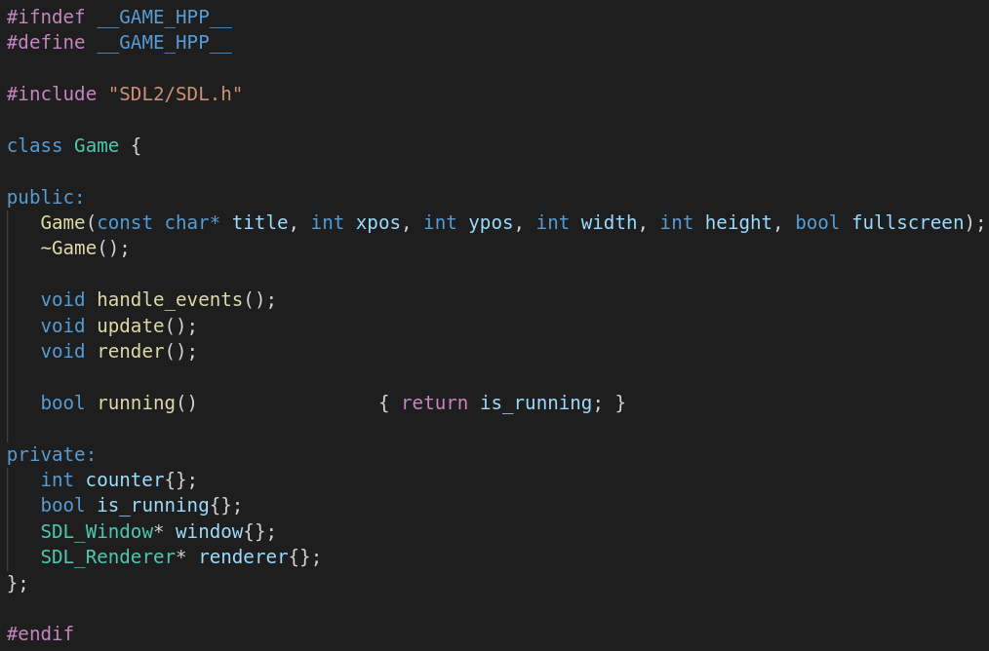
Game.hpp : Improved
init() and clean() removed, functionality moved to constructor/destructor
No default constructor

Slide 11
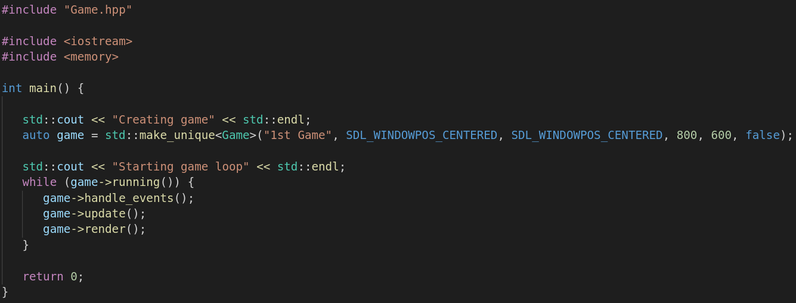
Simpler Mainline (main.cpp)
Replace std::unique_ptr<Game> declaration with “auto” because it’s obvious what type is associated with “game” variable

Slide 12
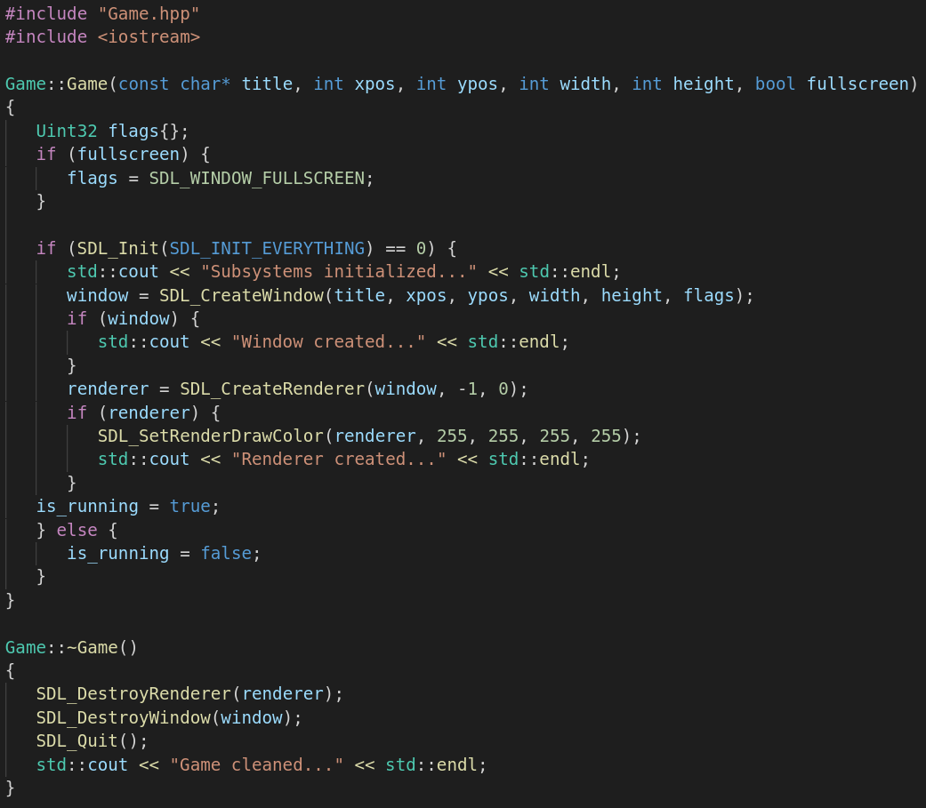
Game.cpp (1) (Constructor and Destructor Replace init() and clean())

Slide 13
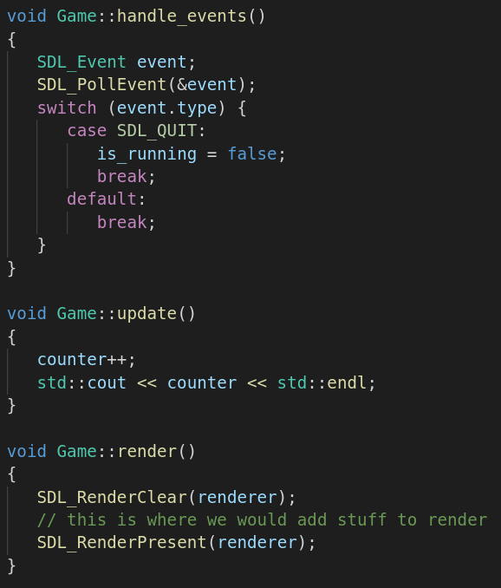
Game.cpp (2)

Slide 14
What if an Error Occurs in the Constructor?

Slide 15
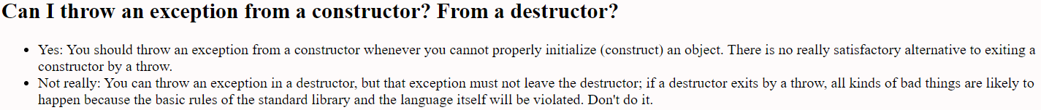
Throw Exception in Constructor!
Reference:
Bjarne Stroustrup’s C++ Style and Technique FAQ
http://www.stroustrup.com

Slide 16
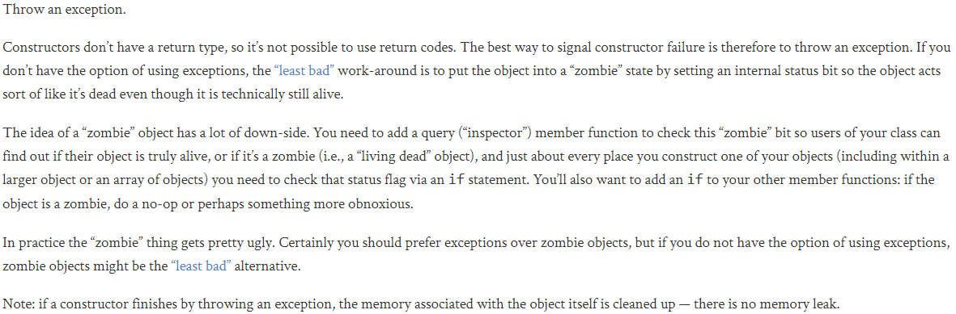
Handling a Constructor that Fails?
Reference: https://isocpp.org

Slide 17
Error Handling
Many resources are available (on the web) concerning this topic
Look for discussions concerning “C++ exception handling”
E.g.: https://www.w3schools.in/cplusplus-tutorial/exception-handling/
Typical errors in programming are “logical errors” and “syntactic errors” – “exceptions” are considered to be run-time anomalies or unusual logical conditions that may come up while executing the C++ program
See chapter 3 “Modularity” in section 13.5 “Error Handling”

Slide 18
Establishing a Frame Rate Reference: https://thenumbat.github.io/cpp-course/index.html

Slide 19
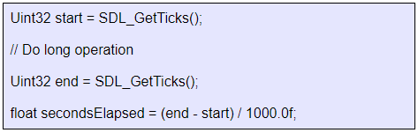
Timing
A simple but convenient API for timing.
Basic form of timing is SDL_GetTicks()
Returns the number of ticks that have elapsed since SDL was initialized
One tick is one millisecond – considered to be a tolerable resolution for physics simulation and animation
To time an interval:
Uint32 ticks = SDL_GetTicks();

Slide 20
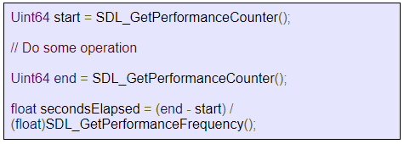
Performance Counters
If you need sub-millisecond resolution
The performance counter is a system-specific high-resolution time – usually on the scale of micro- or nano- seconds
SDL_GetPerformanceCounter() provides the number of performance counter ticks per second
SDL_GetPerformanceFrequency() returns a platform-specific count per second
To time an interval:

Slide 21
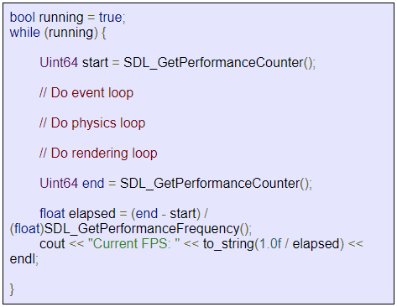
Frame Rate
To calculate the current frames per second (FPS)

Slide 22
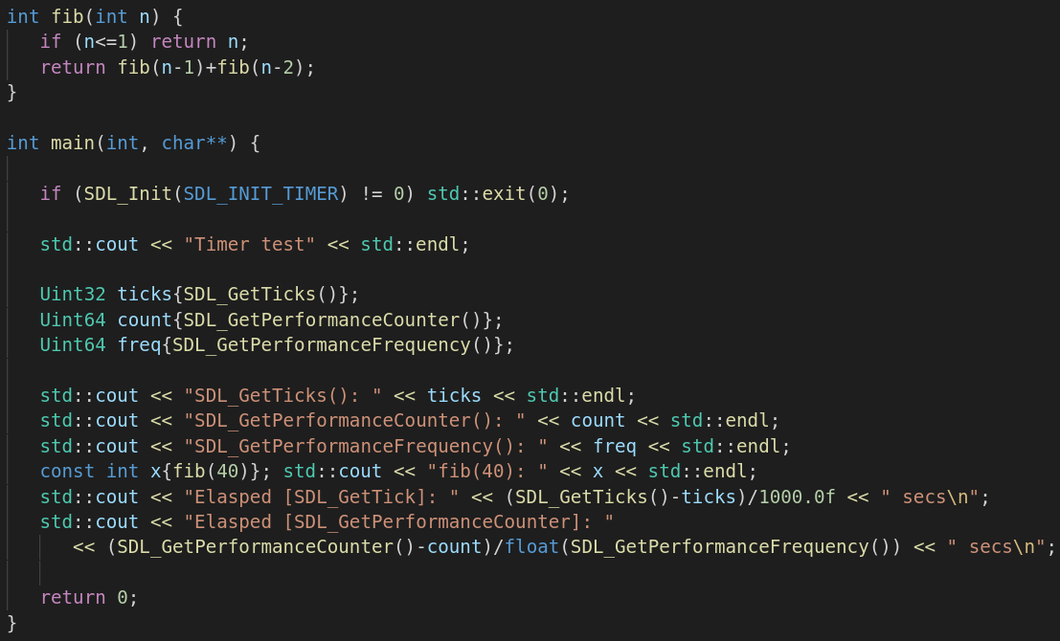
Example Usage

Slide 23
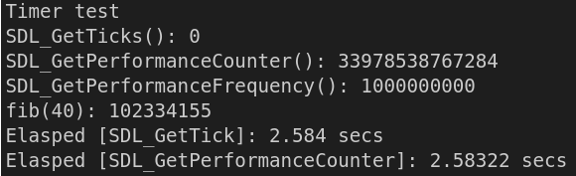
Results
Note: timing could probably be done better... I’m printing to the console during the interval of interest which might skew results

Slide 24
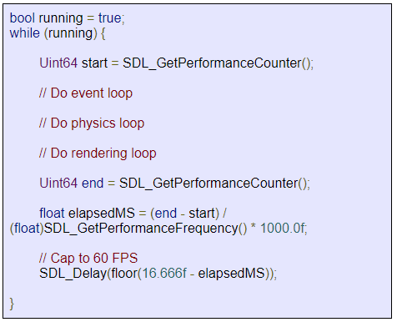
Capping Frame Rate
Capping FPS is good because
Avoids updating the screen too many time per second – avoid tearing
Avoids your program from monopolizing CPU
Simple to implement
Just subtract your frame time from desired time and wait out the difference with SDL_Delay()
Unfortunately, you cannot cap your FPS with much precision with SDL – look at std::chrono for more

Slide 25
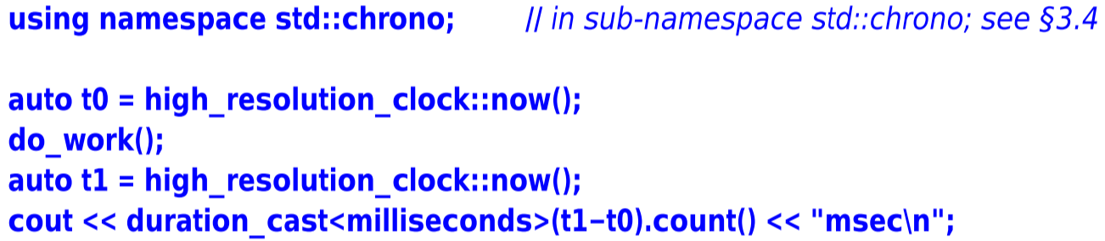
Time
Now a standard interface to getting time from many different sources
See chapter 13 “Utilities” in section 13.7 “Time”

Slide 26
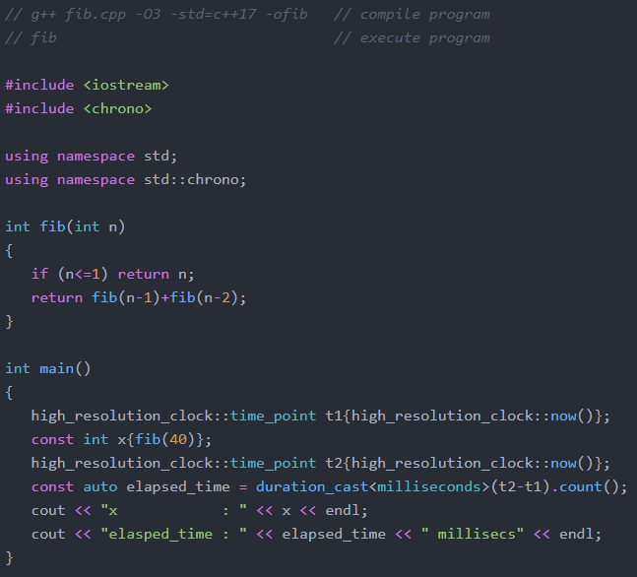
Benchmark: Recursive Fibonacci
C++ Implementation
Calculate the 40th value in sequence and print out result and how much time it took to compute
Elapsed time: 1.6 secs
Note the requirement to explicitly state data types being used… (i.e., statically compiled)

Slide 27
EOF

